Slide 1
Woodlands CS Club
Ad hoc
Group A
01/25/20201

Slide 2
Announcements
Today is last day of USACO (US version of CCC)

Slide 3
Intro
Thinking is more important than knowing a bunch of algorithms
Often overlooked

Slide 4
Misc. helpful problem solving strategies
Read the problem again
Fix a variable
Remove some constraint and solve an easier subproblem
Try putting an upper bound on the answer
Find trivial cases (n=1, etc)
Guess something

Slide 5
CCC ‘17 S3
https://dmoj.ca/problem/ccc17s3

Slide 6
Guiding strategies
Read the problem
Put a bound on the answer
Fix some variable
Find trivial cases

Slide 7
Guiding strategies
Read the problem
N <= 1000, L[i] <= 2000
Subtasks are free marks if we can’t get the whole thing
Farming subtasks is actually so op
Often lead towards the full solution anyway
Put a bound on the answer
Find trivial cases
Fix some variable

Slide 8
Guiding strategies
Read the problem
Put a bound on the answer
The height of the fence has to be <= 4,000 because all L[i] <= 2,000
The longest fence possible is 500,000 because N <= 1,000,000 and each pair adds 1 to the length
We can’t do some naive recursion/etc, as it won’t even get us the smallest subtask
Fix some variable
Find trivial cases

Slide 9
Guiding strategies
Read the problem
Put a bound on the answer
Fix some variable
We know that the height of the optimal fences are in the range [1, 4000] - what if we brute force the height of the best fence?
Find trivial cases

Slide 10
Guiding strategies
Read the problem
Put a bound on the answer
Fix some variable
Find trivial cases
Pick some random height(5)
With array 1, 1, 4, 7, 10, 3, 2, 5, 4 create as many pairs as possible

Slide 11
Guiding strategies
Read the problem
Put a bound on the answer
Fix some variable
Find trivial cases
Pick some random height. We’ll use 5
Pick some random values, we’ll use 1, 1, 4, 7, 10, 3, 2, 5, 4. Now, create as many pairs as possible.
Notice that each possible element has a unique complement that sums to 5! Ex: 1s are always paired with 4, 2 always with 3, and so on.

Slide 12
Naive solution - max(L[i])*N
Brute force height of fence
Iterate over all pairs, maintain a frequency array
For each element in the frequency array, add max(element, complement)
Only go up to height/2. If the current element is height/2 (and height is even) then add floor(freq[i]/2)
Pick best heights
Gets us 9/15 marks (still enough for honour roll xd)

Slide 13
Full solution - (N + L[i]^2)
We don’t need to brute force over the height of the fence! Maintain the number of pairs possible for each height in an array cnt. Iterate over each pair in the frequency array, and add to their respective index in cnt

Slide 14
Full solution code (Java)
https://gist.github.com/pidddgy/a56d879241d8bb4e0187f16b68fe44ff

Slide 15
CCC ‘20 S4 - Swapping Seats
https://dmoj.ca/problem/ccc20s4

Slide 16
Guiding strategies
Read the problem
Fix some variable
Find trivial cases

Slide 17
Guiding strategies
Read the problem
Only 3 letters
N <= 10^6
Fix some variable
Find trivial cases

Slide 18
Guiding strategies
Read the problem
Fix some variable
The state of the ending configuration can be compressed. There are always 3/4 chunks of letters e.g. ‘AAABBBBCCCAAA’ or 'ABBBBBBBCCCCCAA’ or ‘CCBBAA'
What if we brute forced on this ending state?
There are 3! * N possible ending configurations
Find trivial cases

Slide 19
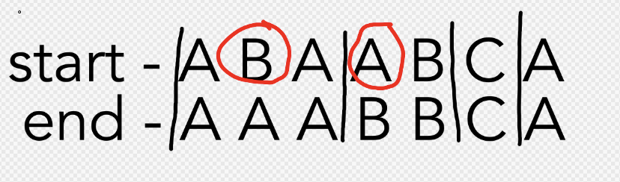
CCC ‘20 S4
In our configuration, consider “chunks” of letters in our end state and each letter that is out of its intended chunk. For example, if our ending configuration is AAABBCA and our initial state is ABAABCA, the B is in an A chunk and there is an A in a B chunk.

Slide 20
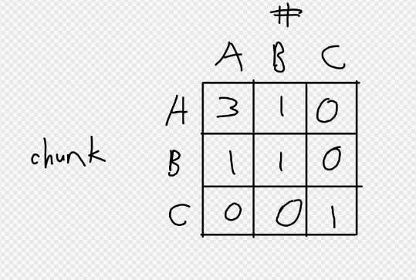
CCC ‘20 S4
Given our ending configuration (goal) and initial state, we can imagine a 2d matrix where each row corresponds to each chunk, and each column represents how much of each letter is in each chunk. To implement this we can use a prefix sum array to count letters in ranges.

Slide 21
CCC ‘20 S4
(handwavy) Obviously we have to swap all the non-A’s out of the A chunk. So, to improve the answer wouldn’t it be better to attempt to swap the non-A’s into their intended chunk in one move, rather than multiple?
Once we are done moving all of the non-A’s out of the A chunk, we only have to fix the B and C chunk. Obviously, since the A chunk is all A now, for every C in the B chunk there is a B in the C chunk and vice versa. So, we just add the number of B in the C chunks to the swaps needed.
You can get the intuition behind this by trying some small cases by hand.
BBAAACCA -> AAABBCCA
CBCB -> BCCB
If you’re confused, you can always try picking some random strings and trying it out! Don’t go too big or else it will take a while to do by hand

Slide 22
Full solution code (C++)
https://gist.github.com/pidddgy/47653f3288620f774a1ac9c0952bd8d4

Slide 23
Debugging

Slide 24
Fast slowing
Ever wondered what case your code doesn’t handle properly? Get free cases on demand
Write a brute force solution that you know is correct
Write a generator that randomly makes test cases
Repeatedly generate small cases and see when your brute force solution produces a different result than your fast solution.
If you fast slow and can’t find a case, either your brute force is wrong or you only fail on big cases for some reason
For example, you could use BFS on state to get a 3^n * n brute force for 20s4, which will be fast enough to run cases at n <= 12

Slide 25
Generator code (C++)
20S4: https://gist.github.com/pidddgy/98a22f506e55f12ea6f199f514ff3667
Make sure to use chrono::high_resolution_clock::now().time_since_epoch().count();
If you use other forms of random, you might find that it will generate the same number repeatedly due to being seeded by time

Slide 26
Fast slow code
https://gist.github.com/pidddgy/0f74109a625a14116878a6fb2243e819
Just an example, may have to adapt for your language / setup

Slide 27
Next Week:
Next week, we’ll continue looking at dynamic programming! Specifically, we will focus on knapsack problems.
The general problem is: https://dmoj.ca/problem/dpd, but we will be expanding it to many other questions as well.
If you want to do any prior reading or thinking about possible solutions, feel free to read/try the problem beforehand.

Slide 28
General Statement:
You are given N items, each with a weight and value. Given a knapsack with a capacity W, find the maximum value you can obtain where the sum of the items used is <= W.

